Slide 1

Challenges,Build Tools,Test and Measurement Equipments for Embedded System Design
DAY 3
EMBEDDED SYSTEM DESIGN & IoT-Master Class

Slide 2
What You will learn Today?
Basic Elements of Embedded System Design
Compiler ,Assembler , Linker ,Loader
Programming Techniques
Common Embedded Peripherals
Test and Measurement Equipment's

Slide 3
Day 3 Challenges,Build Tools,Test and Measurement Equipments for Embedded System Design

Slide 4
Mindset Lesson for the Day
Imagination and Visualization is more important than Knowledge
Exercise
Sketch a picture of what your ultimate life would look like.

Slide 5
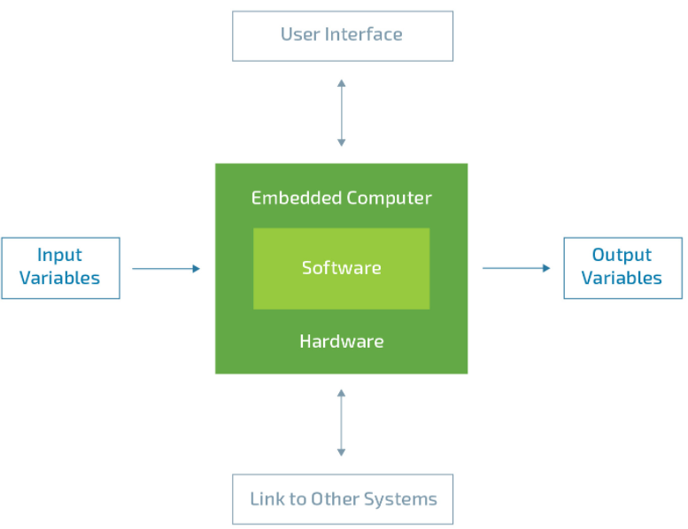
Basic Elements of Embedded System
Keyboard,Keypad,Mouse,Touch Panel
Sensors
DISPLAY DEVICE/Motors/Relays

Slide 6
Input Variables-Sensors
ANALOG SENSORS
DIGITAL SENSORS
Other devices Interfaced using Protocol
Bluetooth
Wifi
Lora
Vision and Imaging Sensors
Temperature Sensors
Radiation Sensors
Proximity Sensors
Pressure Sensors
Position Sensors
Photoelectric Sensors
Particle Sensors
Motion Sensors
Metal Sensors
Level Sensors
Leak Sensors
Humidity Sensors
Gas and Chemical Sensors
Force Sensors
Flow Sensors
Flaw Sensors
Flame Sensors
Electrical Sensors
Contact Sensors
Non-Contact Sensors

Slide 7
User Interface
Keyboard/Key Pad
Touch Panel or Touch screen
Mouse

Slide 8
Output Variables
Actuator -Motors,Relays
Display Devices
LED ,SEVEN SEGMENT
LCD
TFT DISPLAY
VGA /HDMI Monitor

Slide 9
What is IDE
Compiler,Assembler,linker, Loader
Editor Window, Console window, Project window
Debug/ Release
Memory window
Register window
Break points, Watch points
Debugger
Programming Options

Slide 10
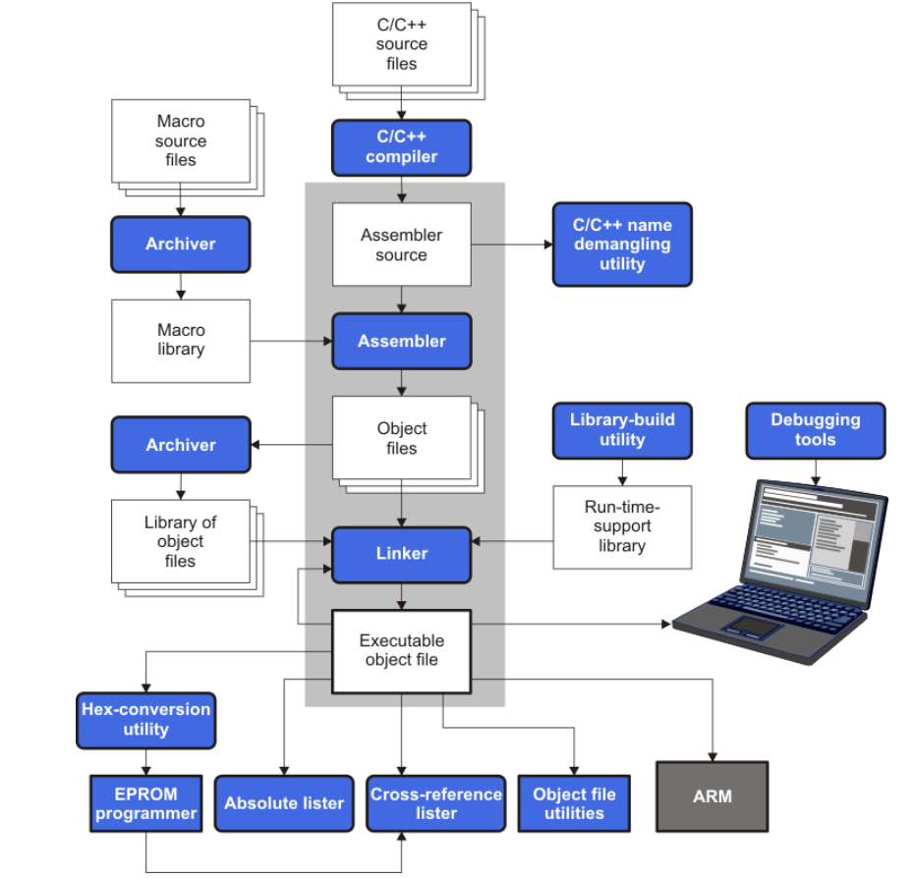
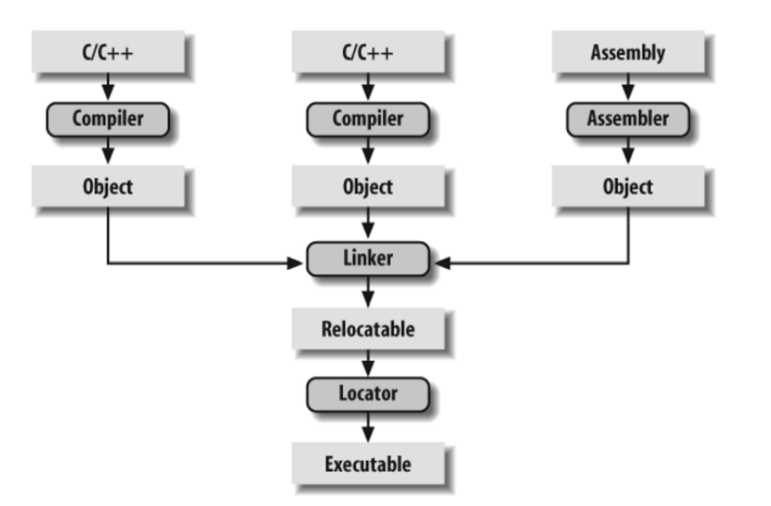
Software development flow

Slide 11
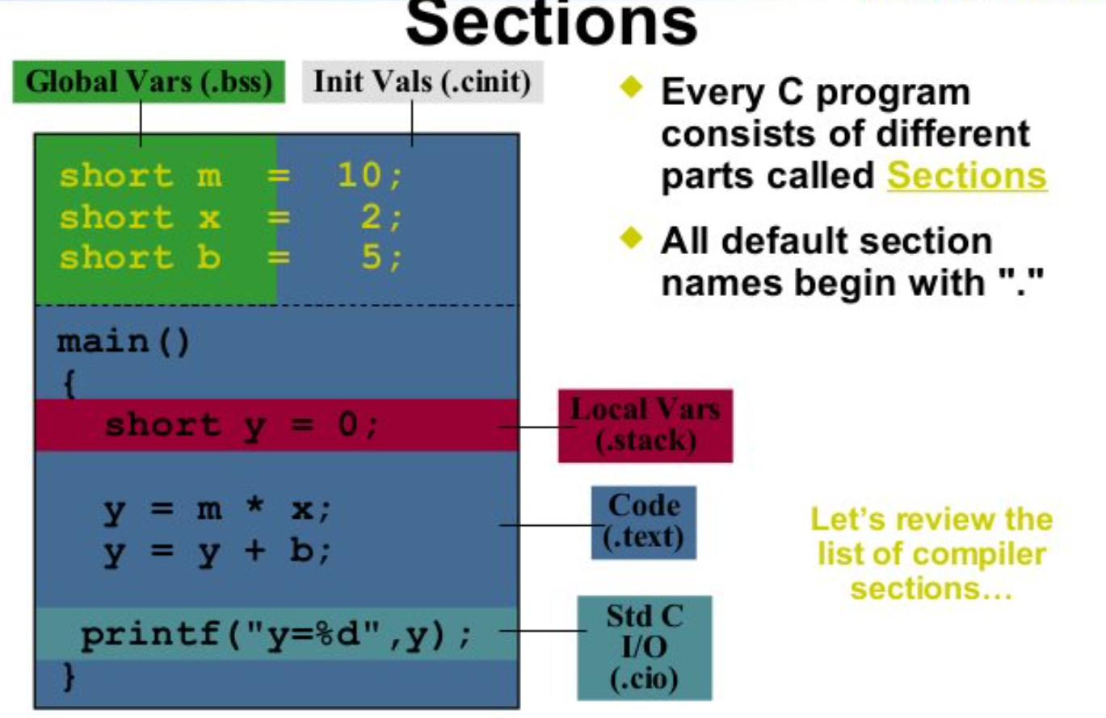
Linker Description file

Slide 12
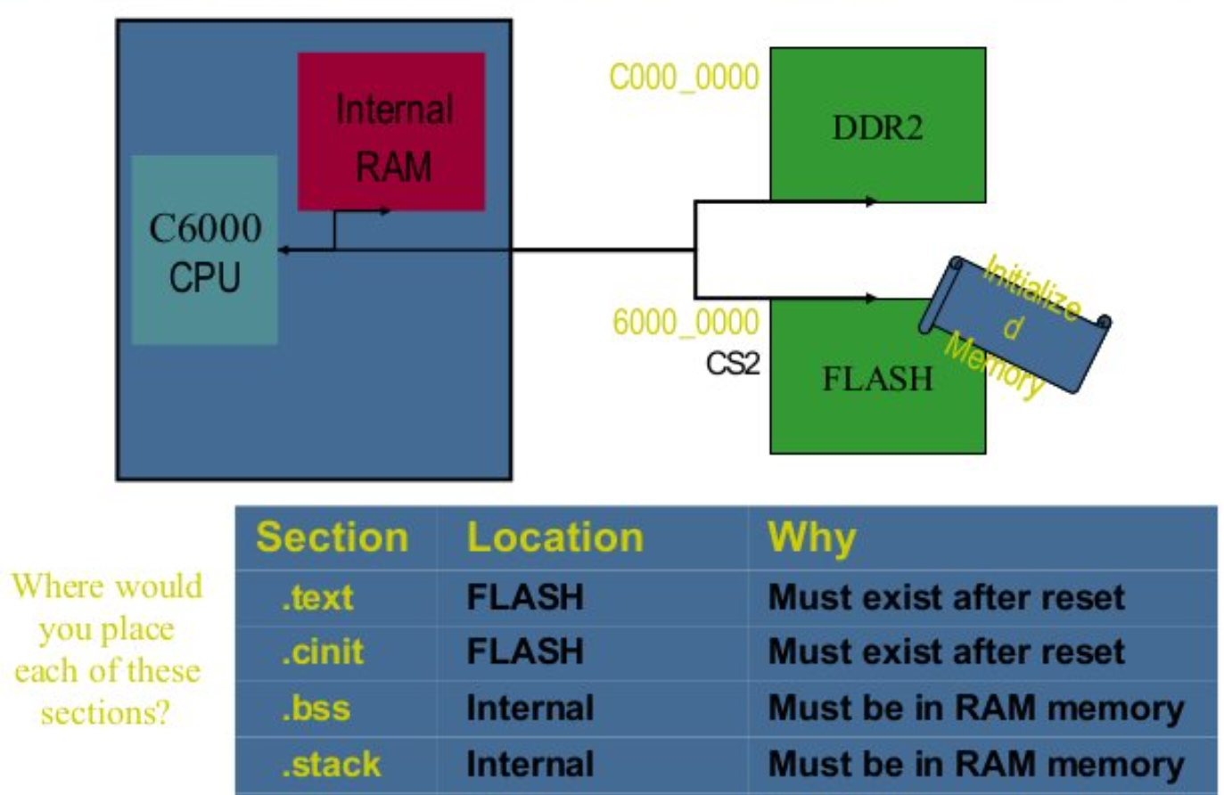
Linker Description file

Slide 13
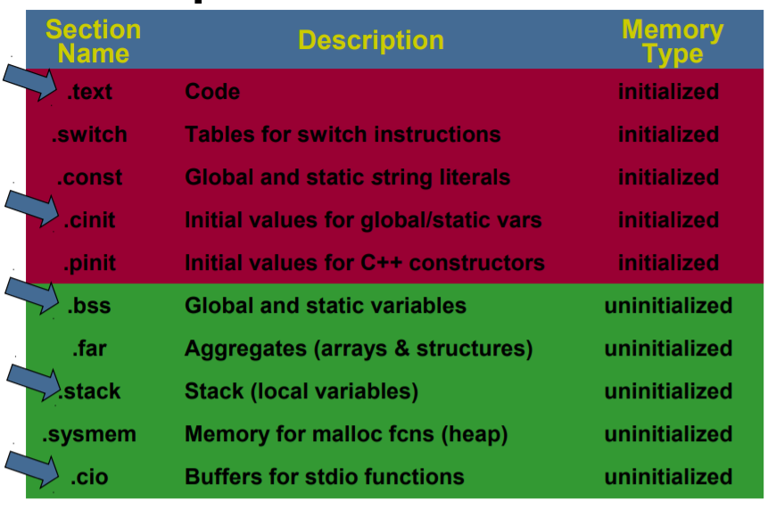
Compiler Section Names

Slide 14
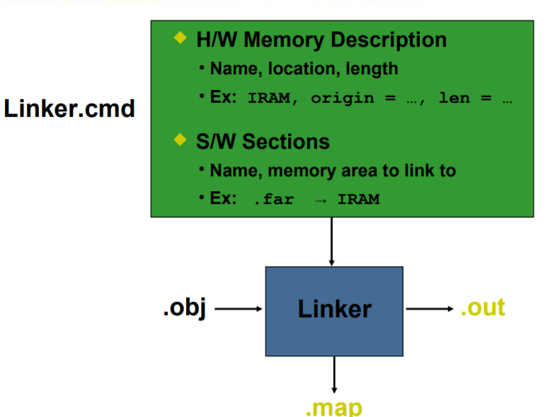
Structure of Linker file

Slide 15
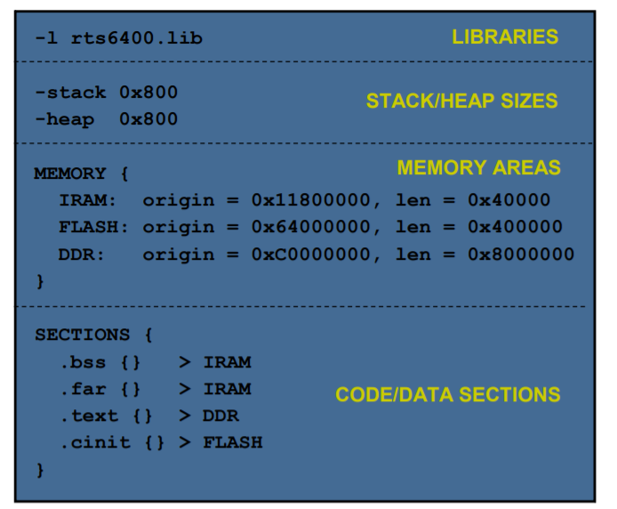
Sample Linker Command file

Slide 16
Programming Techniques
ISP
ICSP
IAP
JTAG

Slide 17
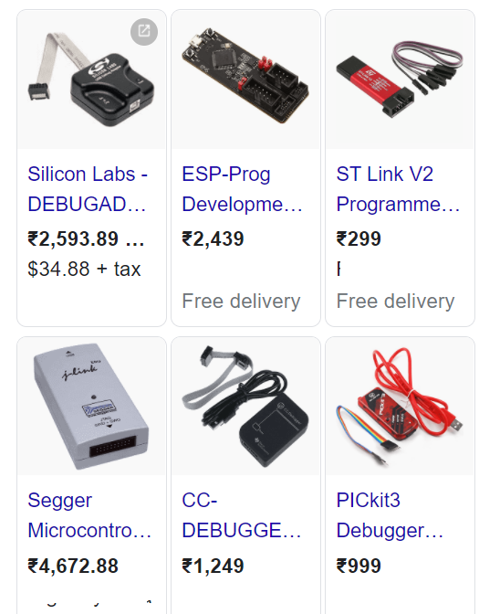
JTAG
The main advantage offered by utilizing boundary scan technology is the ability to set and read the values on pins without direct physical access.
TCK
TMS
TDI
TDO
TRST

Slide 18
Common Embedded Peripherals
GPIO controllers
Timers
PWM controllers
DACs
ADCs
Serial Communication Controllers for UART, SPI, I2C, and Ethernet
Memory
Interrupt controllers and
Direct Memory Access controllers (DMA)
CAN(Controller Area Networks)
LIN( Local Interconnect Network)
JTAG
USB
Videos Ports
Audio Ports
Display Drivers (VGA,TFT,HDMI )

Slide 19
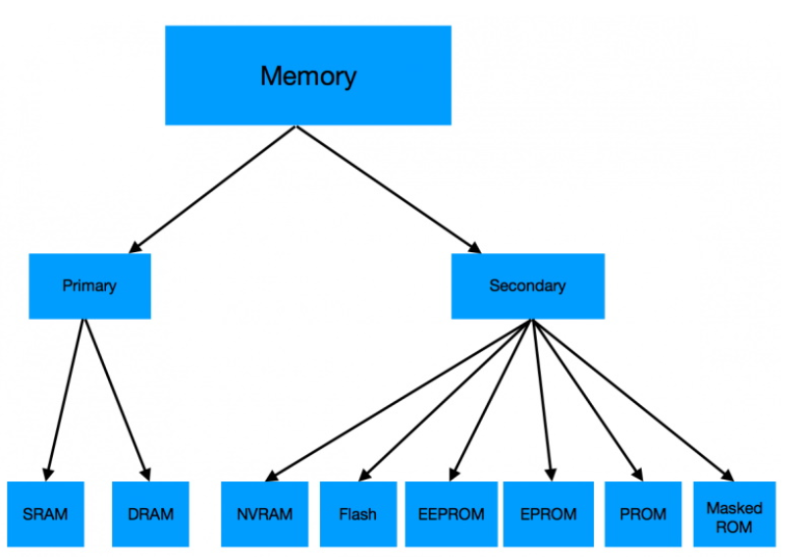
Memories
Static Random Access Memory (SRAM)
Dynamic Random Access Memory (DRAM)
-SDRAM (synchronous DRAM)
-DDR SDRAM(Double data rate synchronous DRAM)
NVRAM(Non Volatile Random Access Memory)
FLASH
EEPROM(ELECTRICALLY ERASABLE PROM)
EPROM(ERASABLE PROM)
PROM
MASKED ROM

Slide 20
WHAT IS UART
Universal asynchronous receiver and tranmitter
Serial port, COM port, RS232, RS485
VERY COMMON AND SIMPLE
Useful for communication to
Microcontroller
Computer
Other FPGA

Slide 21
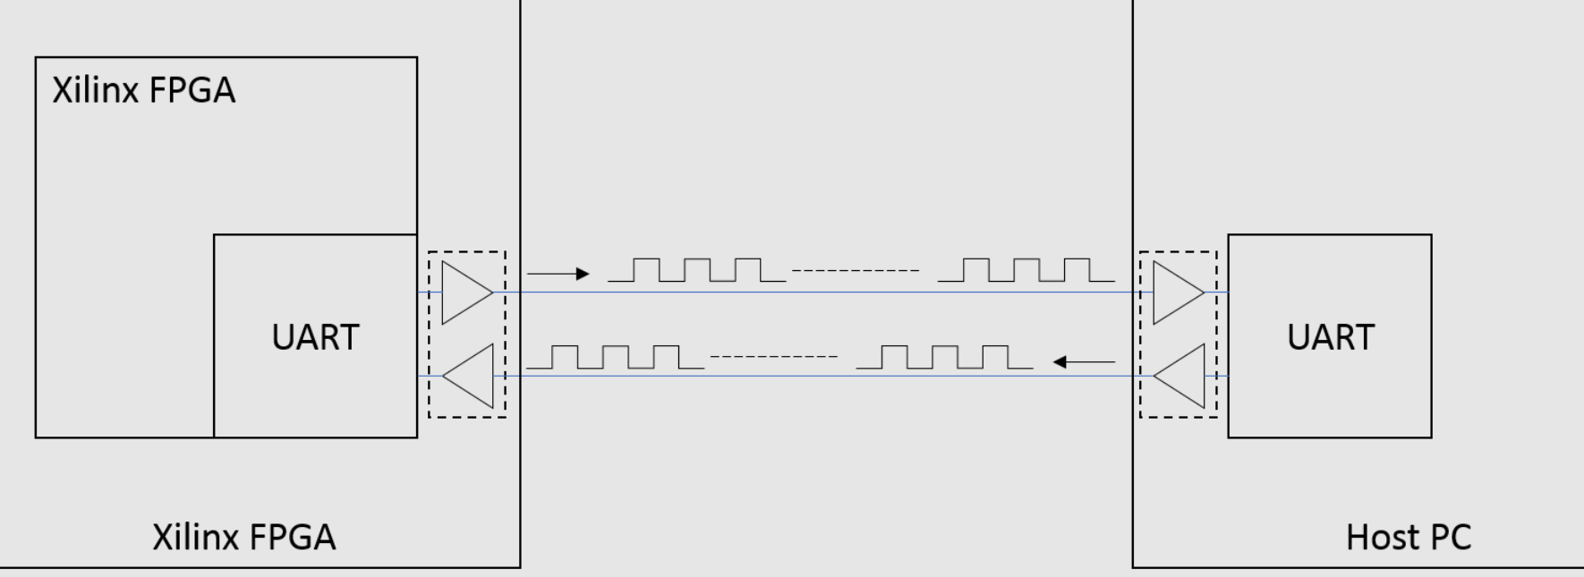
UART

Slide 22
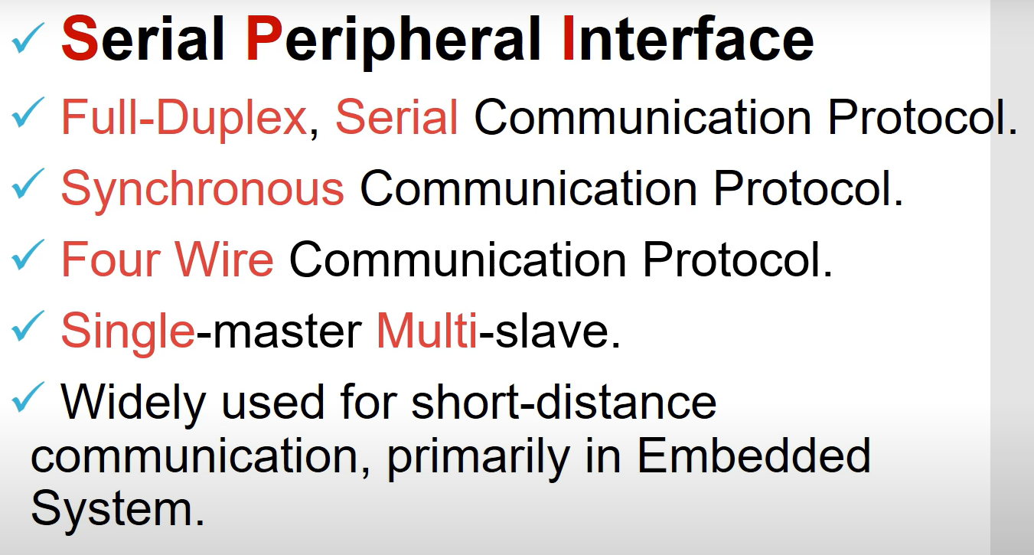
Introduction to SPI

Slide 23
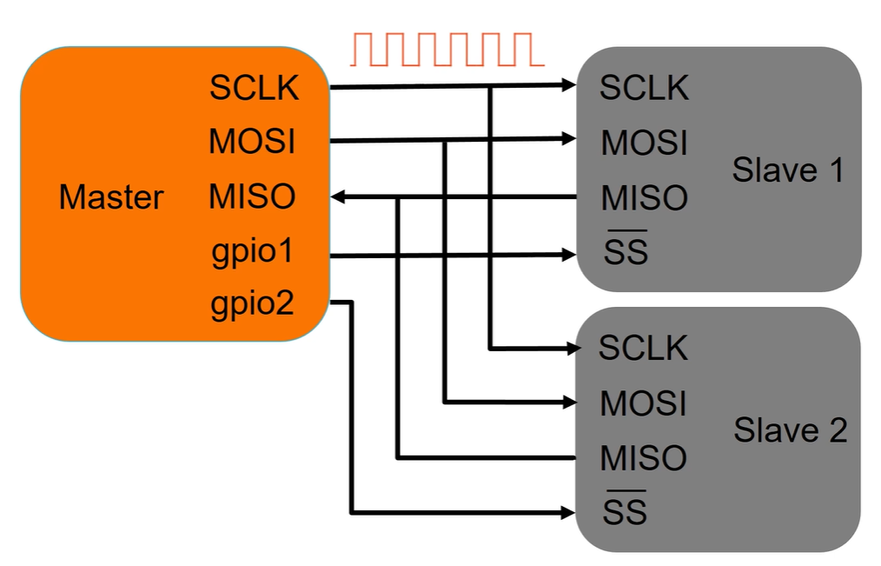
Master and Slave Mode –Multiple Slave

Slide 24
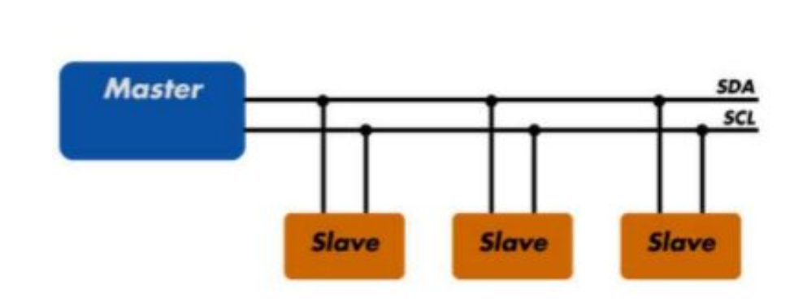
I2C
I2C combines the best features of SPI and UARTs. With I2C, you can connect multiple slaves to a single master

Slide 25
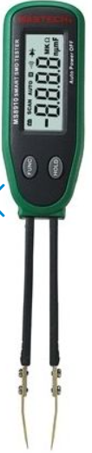
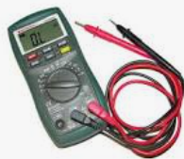
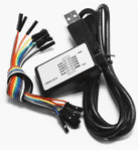
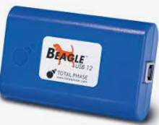
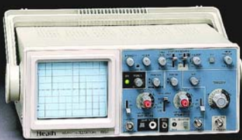
Test and Measurement Equipment's for ESD
MULTIMETER
LOGIC ANALYZER
PROTOCOL ANALYZER
SMD TESTER
DSO/MSO

Slide 26
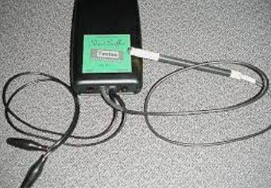
Short circuit locator
Soldering Issue.
Component Failure
Short circuits may also happen during reflow soldering
PCB-Fabrication -thin line of copper remains during fabrication, a hairline short is formed

Slide 27
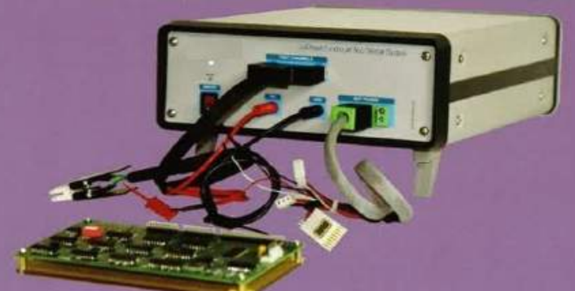
Functionality tester(In circuit Functionality testing)

Slide 28
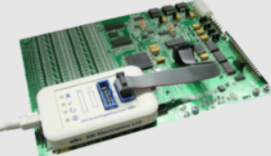
JTAG Testing

Slide 29
Recap
Basic Elements of Embedded System Design
Compiler ,Assembler , Linker ,Loader
Programming Techniques
Common Embedded Peripherals
Test and Measurement Equipment's

Slide 30
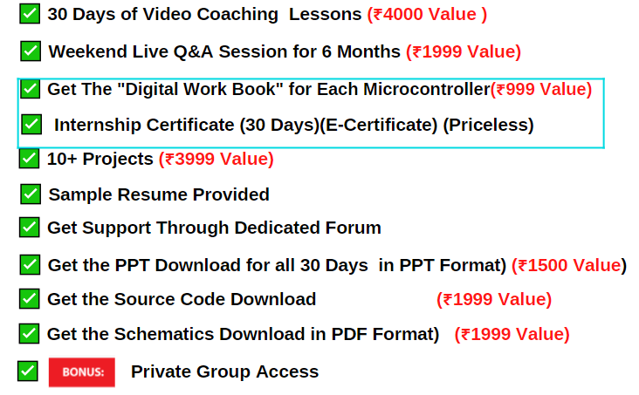
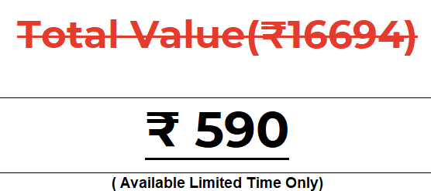
What you get on 30 Days Internship

Slide 31
Thank You

